Slide 1
CSS 422 Hardware and Computer Organization
ARM Data Processing Instructions
Ver. 3
Professor: Munehiro Fukuda

Slide 2
Topics
Shift, rotate, and logical instructions
Condition flags
Multiplication/division by shifts
Arithmetic operations
Carry and overflow
Sign/zero extended instructions
Data movement
Test and compare instructions

Slide 3
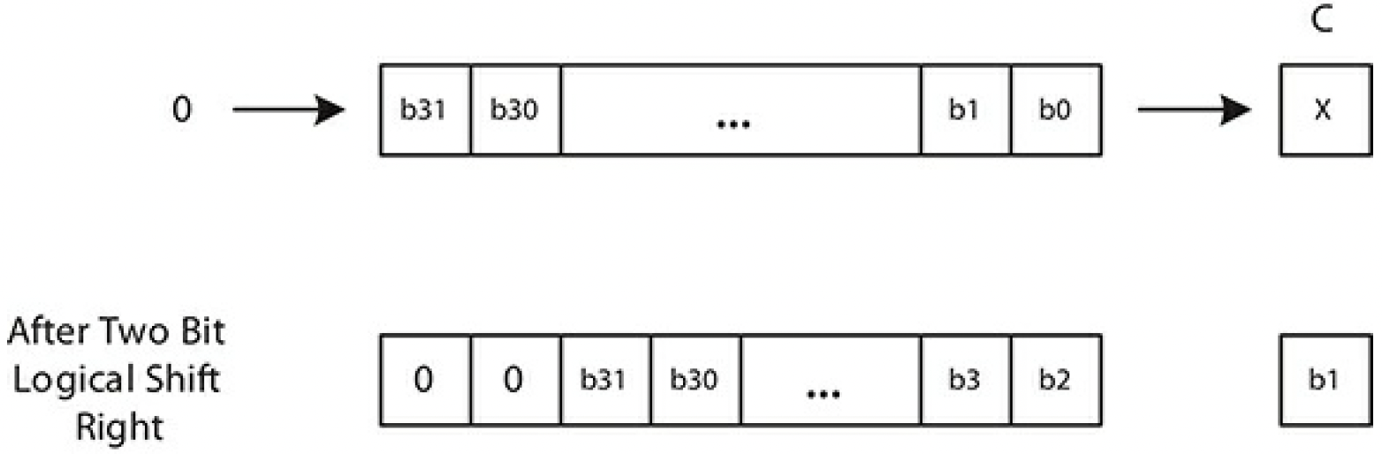
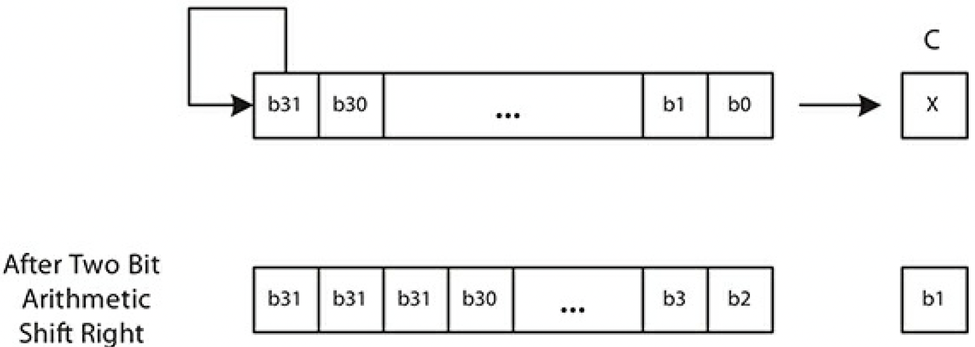
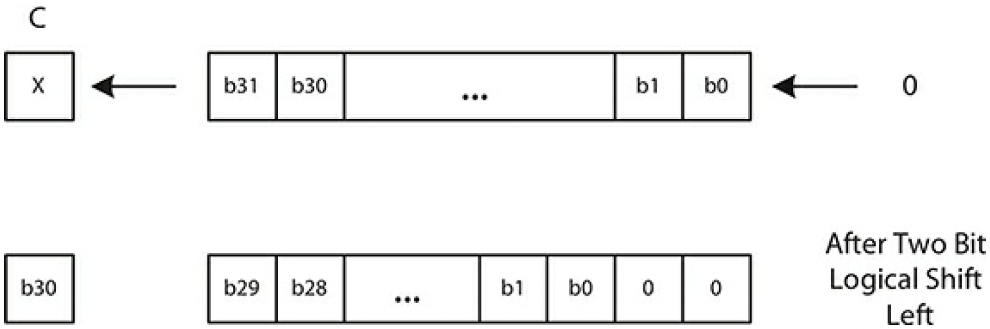
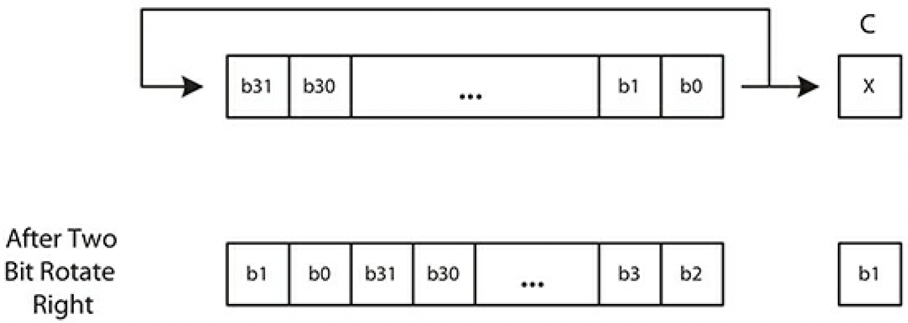
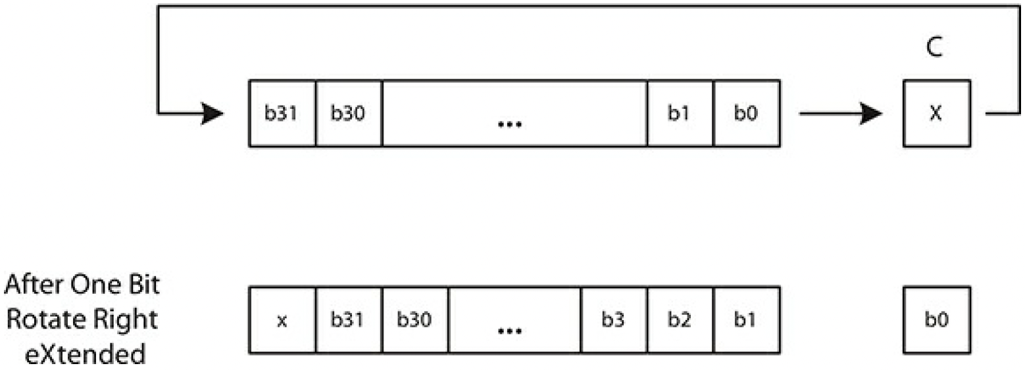
Shift and Rotate Instructions
Instructions | Operation | Bit Movement | Flags | Example
LSR {S}{cond}{.size} Rd, Rm, Rs or #n | Logical Shift Right |  | N, Z, C | LSR R4, R3, R6 ; R4 = R3 >> R6
ASR {S}{cond}{.size} Rd, Rm, Rs or #n | Arithmetic Shift Right |  | N, Z, C | ASRS R4, R2, #3 ; R4 = R2 >> 3 If R2 = #4, (i.e., #0b100 or #2_100) C = 1 If R2 = #3, (i.e., #0b011 or#2_011) C = 0
LSL {S}{cond}{.size} Rd, Rm, Rs or #n | Logic Shift Left |  | N, Z, C | LSLS R2, R1, #5 ; R2 = R1 << 3 If R1 = #0x0FFF, C = 1 If R1 = #0x07FF, C = 0 Both cases make N = 1 (why?)
ROR {S}{cond}{.size} Rd, Rm, Rs or #n | Rotate Right |  | N, Z, C | ROR R2, R2, #29 ; Equivalent to rotate left by 3 bits
RRX {S}{cond}{.size} Rd, Rm | Rotate Right Extended (Just 1 bit rotate) |  | N, Z, C | LSRS R2, R2, #1 ; R2 = R2 >> 1 and C = R2’s LSB RRX R1, R1 ; R1 = ( ( MSB = C) + R1 >> 1 )
Note: each instruction can also include conditional code suffix and instruction size qualifier. RRX is always 32 bits (.W).

Slide 4
Multiplication by Shift
#shifts | Multiply by | Byte Examples (-128 ~ 127)
X << 1 | X * 2¹ = X * 2 | 0000 0001 → 0000 0010 1 → 2
X << 2 | X * 2² = X * 4 | 0000 0001 → 0000 0100 1 → 4
X << 3 | X * 2³ = X * 8 | 0000 0001 → 0000 1000 1 → 8
X << 6 | X * 2⁶ = X * 64 | 0000 0001 → 0100 0000 1 → 64
X << 7 | X * 2⁷ = X * 128 | 0000 0001 → 1000 0000 1 → 128 → –128! Overflow

Slide 5
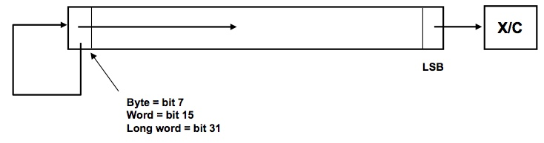
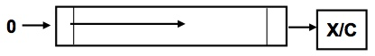
Division by Shift
ASR
LSR
Why does ASR need to keep the content of MSB?
#shifts | Division by | Byte Examples (-128 ~ 127)
X >> 1 | X / 2¹ = X / 2 | 0000 1000 → 0000 0100 8 → 4
X >> 2 | X / 2² = X / 4 | 0000 1000 → 0000 0010 8 → 2
X >> 3 | X / 2³ = X / 8 | 0000 1000 → 0000 0001 8 → 1
How about: – 8 >> 3?
= – 8 / 2³ = –1
1111 1000 → 1111 1111

Slide 6
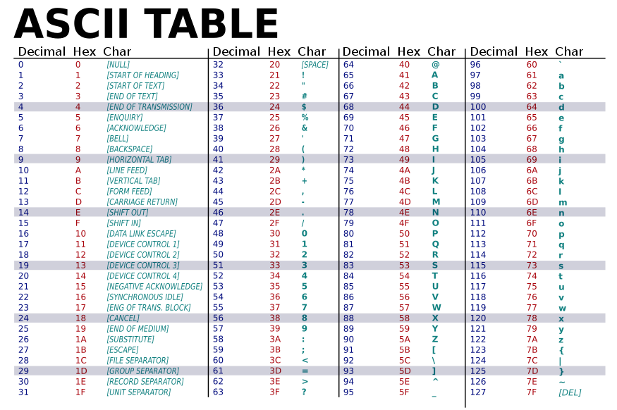
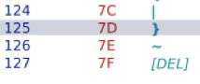
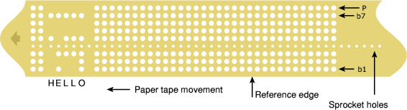
ROR and Parity-Check Program
Where can you use them?
Why didn’t ASCII use 8 bits?
Look at a paper tape that includes the 8th bit (= the parity bit).
How can you count #bits to set a parity without losing the original data?
Repeat 7 times to count each bit of R0
RORS R0, R0, #1 ; rotate each bit
ADDCS R1, R1, #1 ; if it’s 1, increment #ones (=R1)
...
ROR R0, R0, #25 ; rotate R0 back to the original value
1 | 1 | 1 | 0 | 0 | 0 | 0 | 1 | 1 | 0
0 | 0 | 0 | 0 | 0 | 0 | 0 | 0 | 0 | 0
0 | 0 | 0 | 1 | 1 | 0 | 1 | 1 | 0 | 1
0 | 0 | 0 | 1 | 1 | 0 | 1 | 1 | 0 | 1
0 | 1 | 1 | 0 | 0 | 0 | 0 | 0 | 0 | 0
0 | 0 | 0 | 1 | 0 | 1 | 1 | 0 | 1 | 0
1 | 1 | 0 | 1 | 1 | 0 | 1 | 1 | 0 | 0
1 | 0 | 1 | 1 | 0 | 0 | 1 | 1 | 0 | 1
odd parity

Slide 8
Logical Instructions
Instructions | Operation | Flags | Example with the corresponding C-language operations
AND {S}{cond}{.size} {Rd,} Rn, Op2 | Logical AND | N, Z, C | AND R2, R1, #0xFF00 ; R2 = R1 & 0xFF00
BIC {S}{cond}{.size} {Rd,} Rn, Op2 | Bit clear | N, Z, C | BIC R5, R1 ; R5 = R5 & (~R1)
EOR {S} {cond}{.size} {Rd,} Rn, Op2 | Exclusive OR | N, Z, C | R4, R1, #0x0055; R4 = R1 ^ 0x0055
ORN {S} {Rd,} Rn, Op2 | Logical OR NOT | N, Z, C | ORN R5, R1 ; R5 = R5 | (~R1)
ORR {S} {cond}{.size} {Rd,} Rn, Op2 | Logical OR | N, Z, C | R3, R1, R5 ; R3 = R1 | R5
Note: each instruction can also include conditional code suffix and instruction size qualifier (.W or .N) . ORN is always 32 bits (.W).
Operand2 (Op2) can be:
Constant (#imm8): 0x000000AB, 0x00AB00AB, 0xAB00AB00, 0xABABABAB
(see: https://www.keil.com/support/man/docs/armasm/armasm_dom1361289851958.htm)
Register: Rm
Register with Optional Shift: Rm, ASR #n|LSL #n|LSR #n|ROR #n|RRX

Slide 9
Flexible Second Operand
ASR #n | Arithmetic shift right n bits, 1 <= n <= 32 *
LSL #n | Logical shift left n bits, 0 <= n <= 31 #
LSR #n | Logical shift right n bits, 1 <= n <= 32 *
ROR #n | Rotate right n bits, 1 <= n <= 31
RRX | Rotate right one bit, with extend.
 | If omitted, no shift occurs, equivalent to LSL #0.
* Why ASR #32? Why LSR #32? What happens to Rm?
# Why LSL #0? What happens to Rm? What does it mean mathematically?

Slide 10
Bit Manipulations
Testing the N^{th} bit of a variable, R0
MOV R1, #1
LSL R1, #N ; N must be an integer. R1 = 1 << N
ANDS R1, R1, R0 ; R1 = R0 & R1. If R0’s nth bit is 1, APSR’s Z bit = 0.
Extracting only most significant byte of R0
AND R1, R0, #0xF000 ; R1 = R0 & 0xF000
LSR R1, #24 ; R1 = R1 >> 24, so that R1 gets R0’s most significant byte in its least significant byte position
Setting the N^{th} bit
MOV R1, #1
LSL R1, #N ; N must be an integer. R1 = 1 << N
ORR R0, R0, R1 ; R0 = R0 | R1
Clearing the N^{th} bit
MOV R1, #1
LSL R1, #N ; N must be an integer
BIC R0, R0, R1 ; R0 = R0 & ~R1
Counting #bits
RORS R0, R0, #1 ; rotate each bit
ADDCS R1, R1, #1 ; if it’s 1, increment #ones (=R1)
...
ROR R0, R0, #25 ; rotate R0 back to the original value

Slide 11
Basic Arithmetic Instructions
Instructions | Operation | Flags | Example with the corresponding C-language operations
ADD {S}{cond}{.size} {Rd,} Rn, Op2 | Addition | N, Z, C, V | ADD R2, R1, R3; R2 = R1 + R3
ADC {S}{cond}{.size} {Rd,} Rn, Op2 | Add with carry | N, Z, C, V | ADC R2, R1, R3; R2 = R1 + R3 + C, where C is Carry.
SUB {S} }{cond}{.size} {Rd,} Rn, Op2 | Subtract | N, Z, C, V | SUBS R8, R6, #240; R8 = R6 – 240, sets flags on the result
SBC {S} }{cond}{.size} {Rd,} Rn, Op2 | Subtract with carry | N, Z, C, V | ORN R5, R1 ; R5 = R5 | (~R1)
RSB {S} }{cond}{.size} {Rd,} Rn, Op2 | Reverse subtract | N, Z, C, V | RSB R4, R4, #1280; R4 = 1280 – R4 *
ADDW {cond} {Rd,} Rn, #imm12 | Addition (32-bit encoded) No S option |  | ADDW R5, #4095 ; R5 = R5 + 4095
SUBW {cond} {Rd,} Rn, #imm12 | Subtraction (32-bit encoded) No S option |  | SUBW R5, #4095 ; R5 = R5 – 4095
* why do we need RSB?
carry
+
64-bit sum can be obtained from:
ADDS R4, R0, R2
ADC R5, R1, R3
63 ..................................... 32
31 ...................................... 0
R1
R0
+
+
R3
R2

Slide 12
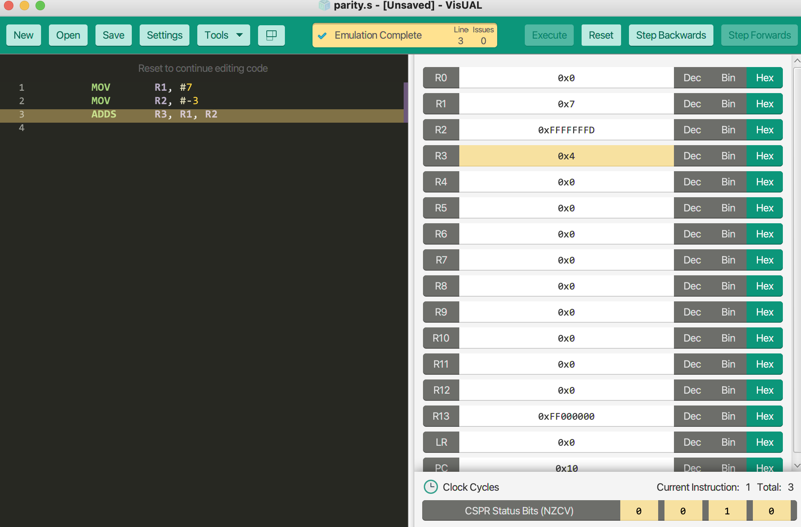
Carry and Overflow
In 4-bits system, (range -8 to 7)
7 + (-3) = 4
(-7) + ( -8)
No overflow: V=0, C= 1
carry-out bit is invisible.
Then the answer is 4 (correct)
0 111
+
1 101
carry = 1
0 100
1 001
+
1 000
Overflow (sign bit changed to 0) : V=1, C= 1.
Incorrect result, error.
carry = 1
0 001

Slide 13
Multiply Instructions
Instructions | Operation | Flags | Example with the corresponding C-language operations
MUL {S}{cond} {Rd,} Rn, Rm | Multiply Rd = Rn * Rm | N, Z | MULS R1, R2, R5; R1 = R2 * R5, set flags.
MLA {cond} {Rd,} Rn, Rm, Ra | Multiply with Accumulate No S option, Rd = (Rn * Rm) + Ra |  | MLA R1, R2, R3, R5; R1 = (R2 * R3) + R5
MLS {cond} {Rd,} Rn, Rm, Ra | Multiply with Subtract No S option, Rd = Ra – (Rn * Rm) |  | MLS R1, R5, R6, R7 ; R1 = R7 – (R5 * R6) *
UMULL {cond} RdLow, RdHigh, Rn, Rm | Unsigned Multiply Long [RdHigh RdLow] = Rn * Rm |  | UMULL R0, R4, R5, R6 ; unsigned [R4 R0] = R5 * R6
UMALL {cond} RdLow, RdHigh, Rn, Rm | Unsigned Multiply with Accumulate Long [RdHigh RdLow] += Rn * Rm |  | UMAL R4, R5, R3, R8 ; unsigned [R5 R4] += R3 * R8
SMULL {cond} RdLow, RdHigh, Rn, Rm | Signed Multiply Long [RdHigh RdLow] = Rn * Rm |  | UMULL R0, R4, R5, R6 ; signed [R4 R0] = R5 * R6
SMLAL {cond} RdLow, RdHigh, Rn, Rm | Signed Multiply with Accumulate with Long [RdHigh RdLow] += Rn * Rm |  | UMAL R4, R5, R3, R8 ; signed [R5 R4] += R3 * R8
* Why not (R5 * R6) – R7? See page 13.

Slide 14
Divide Instructions
Instructions | Operation | Flags | Example with the corresponding C-language operations
SDIV {cond}{.size} Rd, Rn, Rm | Signed Division No S option |  | SDIV R1, R2, R4; R1 = R2 / R4, signed
UDIV {cond} Rd, Rn, Rm | Unsigned Division No S option |  | UDIV R1, R8, R2; R1 = R8 / R2, unsigned
To compute R2 = R0 / R1 as well as R3 = R0 % R1.
SDIV R2, R0, R1 ; R2 = R0 / R1
MLS R3, R1, R2, R0 ; R3 = R0 – (R2 * R1)

Slide 15
Data Movement Instructions
Instructions | Operation | Flags | Example
MOV {S}{cond} Rd, Operand2 | Rd = Operand2 | N, Z, C | MOVS R11, #0x000B ; R11 = 0x000B, N=0, Z=0, C=0
MOV {cond} Rd, #imm16 | Rd = #imm16 |  | MOV R1, #0xA05 ; R1 = 0xA05, flags unchanged
MOVW {cond} Rd, #imm16 | Rd = #imm16 |  | MOVW R2, #0xFED; R2 = 0xFED, flags unchanged
MOVT {cond} Rd, #imm16 | Rd = #imm16 << 16 |  | MOV R3, #0x456 ; R3 = 0x00000456 MOVT R3, #0xF123 ; R3 = 0xF1230456
MVNS {S}{cond} Rd, Operand2 | Rd = ~Operand2 | N, Z, C | MVNS R2, #0xF ; R2 = 0xFFFFFFF0, N=1, Z=0, C=0

Slide 16
Move Instruction Execution
Register Transfer Language (RTL)
MAR ← PC, PC ← PC + 2
IR ← mem[MAR]
R0 ← {IR[14:12],IR[7:0]}

Slide 17
Bitfield Instructions
Instructions | Operation | Flags | Example
BFC {cond} Rd, #lsb, #width | Bit Field Clear |  | ; let R1 = 0x11223344 BFC R1, #4, #8 ; R1 = 0x112230004
BFI {cond} Rd, Rn, #lsb, #width | Bit Field Insert |  | ; let R2 = 0x5577AACC, R3 = 0x00000123 BFI R2, R3, #4, #14 ; R2 = 0x5577123C, R3 unchanged
REV {cond} Rd, Rn | Reverse byte order in a word |  | ; let R1 = 0x12345678 REV R2, R1; R2 = 0x78563412
SBFX {cond} Rd, Rn, #lsb, #width | Signed Bit Field Extract |  | ; let R1 = 0xAABB5533, R2 = 0x00000000 SBFX R2, R1, #16, #16 ; R2 = 0xFFFFAABB ,R1 unchanged
UBFX {cond} Rd, Rn, #lsb, #width | Unsigned Bit Field Extract |  | ; let R1 = 0xAABB5533, R3 = 00000000 UBFX R3, R1, #4, #8 ; R3 = 0x00000053 ,R1 unchanged

Slide 18
Test and Compare Instructions
Instructions | Operation | Flags | Example
CMN {cond} Rd, Operand2 | Compare Negative | N, Z, C, V | ; let R1 = 0x7FFFFFFF, R2 = 0x00000001 CMN R1, R2 ; N = 1, Z = 0, C = 1, V = 1
CMP {cond} Rd, Operand2 | Compare | N, Z, C, V | ; let R1 = 0, R2 = 1 CMP R1, R2 ; N = 1, Z = 0, C = 0
TEQ {cond} Rd, Operand2 | Test Equivalence: performs a bitwise EORS. | N, Z, C | ; let R1 = 0x12345678, R2 = 0x12345678 TEQ R1, R2 ; N = 0, Z = 1
TST {cond} Rd, Operand2 | Test: performs a bitwise AND operation | N, Z, C | ; let R1 = 0x00000001, R2 = 0x00000009 TST R1, R2 ; N = 0, Z = 0
Why do CMN and CMP update V flags while TEQ and TST don’t?

Slide 19
Summary
How can LSL and ASR implement multiplication and division?
How does ARM implement its flexible operand 2?
Why do we need ADC besides ADD?
How useful is REV?
Why do CMP and CMN change C and V flags?

